Slide 1
DIT 219: PROGRAMMING WITH JAVA Unit1: Lesson1 Introduction to JAVA
By
Dr. Frimpong Twum
Senior Lecturer, Dept. of Computer Science, KNUST

Slide 2
Learning Objectives
After studying this unit, you should be able to:
Explain the features of Java
Explain the Java Magic – Byte Code
Obtain and install the JDK and Eclipse IDE
Use Eclipse IDE
Explain how JAVA works

Slide 3
Why Learn Java?
Java remains one of the most popular computer programming languages.
Mobile Android development is done in Java
Lots of enterprise applications have been developed and are still being developed with Java
Large code base of already written applications
Java is Object-Oriented Programming Language
Java is Platform Independent
There are several million of professional Java developers out there who are ready to help

Slide 4
THE LIFE CYCLE OF A JAVA PROGRAM
There are different types of programming languages. In some of them you write the text of the program (source code) and can execute this program right away. These are interpreted languages (e.g., JavaScript).
Java requires the source code of your program to be compiled first. It gets converted to machine-specific code termed (bytecode) that is understood by some run-time engine or a virtual machine.
Not only will the program be checked for syntax errors by a Java compiler, but some other libraries of Java code can be added (linked) to your program after the compilation is complete (deployment stage).

Slide 5
JDK and JRE
JAVA is both a programming language and also a platform
Java Development Kit (JDK) is required to develop and run programs
Java RunTme Environment (JRE) is required to run programs.
Thus, Users of JAVA programs must have the JRE installed to run the program(s), whiles developers needs the JDK to develop JAVA programs and run them. The JDK includes the JRE
We can write the source code of our Java program in any plain text editor that we prefer (Notepad, TextEdit, vi, etc.), but to compile our program we’ll need additional tools and code libraries that are included in the Java Development Kit (JDK).
Because we’ll be developing JAVA programs, we have to download the JDK

Slide 6
Java Editions: SE, EE, and ME
Because we’ll be developing JAVA programs, we have to download the JDK from oracle.com
Java SE: Java Standard Edition (a.k.a. J2SE)
Java EE: Java Enterprise Edition (a.k.a. J2EE)
Java EE includes a set of technologies built on top of Java SE: Servlets, JSP, JSF, EJB, JMS, etc.
Java ME: Java Micro Edition
All Java programs run inside the Java Virtual Machine (JVM or JRE) and this gives JAVA programs the added advantages of been secure and portable

Slide 7
TYPES OF JAVA PROGRAMS
JAVA is general-purpose programming language: Thus we can use JAVA to create:
Stand-alone applications that run independently on the user’s computer
Applet/Servlet that run under the control of a Web browser/Web Sever respectively
What is an Applet?
What is a Servlet?
Midlet: Mobile applications that run on mobile devices

Slide 8
SETTING UP YOUR JAVA DEVELOPMENT ENVIRONMENT
In order to begin creating our Java programs, the ‘Java Class Libraries’ and ‘javac’ compiler needs to be installed on your computer.
In order to run java program, the ‘JRE’ needs to be installed on your computer to supply the ‘java’ interpreter.
All of the above components are contained in a freely downloadable package called the ‘JDK’ from oracle.com
We’ll download J2SE for creating our stand-alone applications (perform a jdk download search on google.com and download the latest version of the JDK for your Operating System) http://www.oracle.com/technetwork/java/javase/downloads/jdk8-downloads-2133151.html

Slide 9
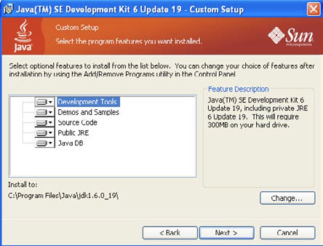
Installing JDK on Windows

Slide 10
SETTING YOUR JAVA PATH and TESTING YOUR DEVELOPMENT ENVIRONMENT
Add the bin folder to the PATH system variable of your computer
(e.g. C:\Program Files\Java\jdk1.6.0_35\bin)
Make sure that the newly installed version is being used. Open Command (or Terminal on MAC) window and type the following:
c:> java –version
To check the Java interpreter (JRE) version installed
c:> javac –version
To check the Java compiler version installed

Slide 11
YOUR FIRST JAVA PROGRAM: HELLO WORLD
Historically, the first program you write while learning a new programming language is the program ‘Hello World’.
As stated earlier we can begin writing our Java source code using any plain text editor and save the file with the same name as our class with .java as file name extension— I’ll use Notepad.
public class HelloWorld
{
public static void main(String[] args)
{
System.out.println(“Hello World”);
}
}

Slide 12
Three steps to run the Java program
Write the program and save it in a file with the name that ends with .java, for example HelloWorld.java
Compile the program using javac compiler, e.g. javac HelloWorld.java
This will create the object code file (bytecode) HelloWorld.class
Run your program: java HelloWorld

Slide 13
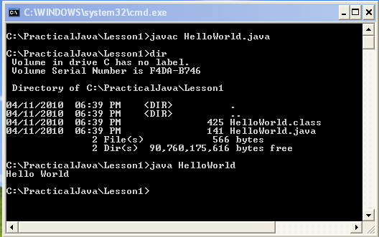
Compiling and running HelloWorld

Slide 14
JAVA PROGRAM STRUCTURE
Source Code File
Class File
Methods
Statements

Slide 15
Eclipse IDE
Integrated Development Environment (IDE) makes your work more productive
Includes text editor, compiler, debugger, context-sensitive help, works with different JDKs
Eclipse is the most widely used IDE
Alternative IDE’s: NetBeans (Oracle), IntelliJ IDEA (JetBrains),

Slide 16
Downloading and Installing Eclipse
Download the latest version of Eclipse for JavaEE (32 or 64 Bit version) from http://www.eclipse.org/downloads
The installation of Eclipse IDE comes down to a simple unzipping the downloaded file into a disk drive of your choice.
You’ll find the file eclipse.exe in the unzipped Eclipse folder — just double-click to run the program.
You’ll immediately see a pop-up window asking you to select a workspace, which is a directory on your hard disk where all of your JAVA projects/Files will be stored.
When we create a JAVA application with Eclipse, we start with creating a workspace for (e.g. c:\Learn_Java) which is a folder where we want to keep all of our Java files
In the real world, (e.g. OO Programming), the source code of our application may consist of several JAVA projects.

Slide 17
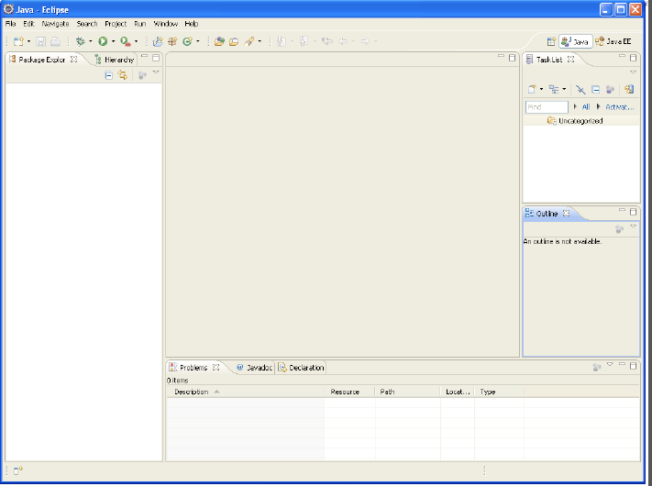
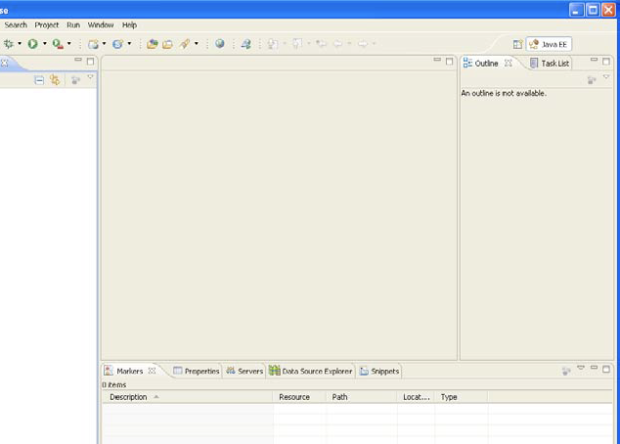
Eclipse Java EE IDE Workspace
Note: This is the location on your hard disk drive where your java projects/files will be saved

Slide 18
Creating a new Project named ‘Hello’ in Eclipse
In Lesson 1 we created a simple JAVA class HelloWorld in notepad, but in Eclipse we have to create a project first.
Select File ➪ New ➪ Java Project and enter Hello as the name of the project in the pop-up window
You can select the version of the JRE you want to work with if you have more than one version of JRE installed
Eclipse IDE does not come with its own JRE, but it allows you to pick the version of JRE installed on your computer that fits your need.
In some cases you may have to compile the code with older versions of JRE especially if you know the program will have to run in the older JVMs.
You specify the folder where compiled Java classes of the Hello project should be created. By default, Eclipse creates a Hello folder for this project with a bin sub-folder for compiled classes and an src sub-folder for the source code.

Slide 19
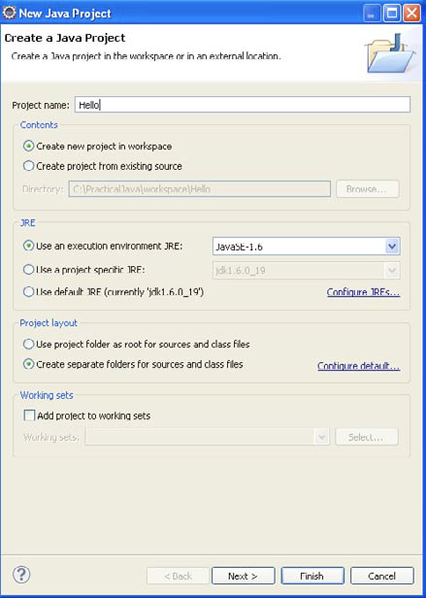
Creating a new Project named ‘Hello’ in Eclipse

Slide 20
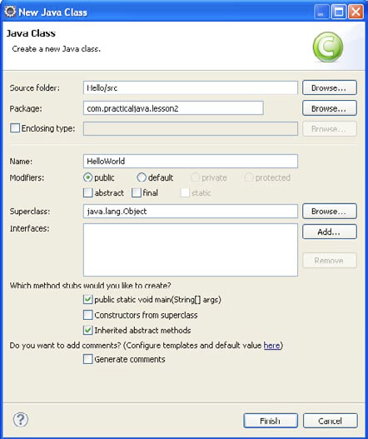
Creating the HelloWorld Class in Eclipse
Our Hello project will contain one Java class: HelloWorld as in Lesson
Select File ➪ New ➪ Class and enter HelloWorld in the Name field in the pop-up window shown.
Then enter com.learnJava.lesson2 in the Package field.

Slide 21
WHAT ARE JAVA PACKAGES?
Java Packages are a group of related Java projects or related Java classes
Packages in Java are ways to better organize multi-file projects and for data protection.
For a typical real world JAVA application, a project usually will have several hundreds of JAVA classes.
Keeping them all in one directory(or project folder) is not a good idea. Hence the files ae usually placed in various project folders and sub-folders.
When organised in this way, we refer to it as Java Package

Slide 22
Java Packages Naming Conventions
Java developers use reverse domain name conventions.
For e.g. Suppose you are working on a project named Sales for a company called Acme, which has an Internet site as acme.com. Then the package name for this project will start with the reverse URL of the company, followed by the project name as follows:
com.acme.sales
All Java classes that belong to the sales package would be stored in the following directory structure:
com/acme/sales
Java has a special keyword package, and its declaration has to be the first line of the class.
For example: package com.acme.sales;

Slide 23
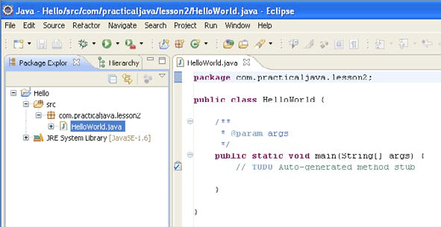
The initial code for the class HelloWorld in Eclipse
By default, saving the code either by pressing the little diskette image on the toolbar or using the Ctrl+S key combination results in an invocation of the compiler.
Eclipse will create HelloWorld.class in the bin directory of the Hello project.
In case of compilation errors, Eclipse puts a little red round bullet in front of problematic lines.
Now you can run the program by pressing the round green button on the toolbar.
The output of the program will be shown in the Console view panel in the lower part of Eclipse IDE

Slide 24
Homework
Create a new project in Eclipse called Unit2 and write a program that output your name and address in the Console view of Eclipse, for example:
Alex Johnson
23 Main Street
New York, NY 10001
USA

